Slide 1

Differentiated Service Delivery:
Taking Innovative Delivery Models to Scale
Wafaa El-Sadr, MD, MPH, MPA
ICAP at Columbia University

Slide 2
Outline
The Promise of Differentiated Service Delivery (DSD)
Scale-up of DSD
Monitoring DSD Coverage and Quality
Way Forward

Slide 3
The promise of Differentiated Service Delivery (DSD)

Slide 4



Much Progress Made, But More Needs to be Achieved
40
35
30
25
20
15
10
5
0
Gap to reaching the first 90:
5.7 million
Gap to reaching the first and second 90s:
8.2 million
Gap to reaching the three 90s:
9.4 million
Number of people living with HIV (millions)
People living with HIV who know their status
People living with HIV on treatment
People living with HIV who are virally suppressed
UNAIDS, Miles to Go, 2018

Slide 5
Barriers to Epidemic Control
Coverage
  Access (geographic, language, cultural competency)
  Demand (uptake by communities and clients)
Quality
  Technical quality (safety, evidence-based)
  Interpersonal quality (respectful care)
Efficiency
  For health system
  For clients

Slide 6




Time to Deliver Differently?
DSD to the rescue?

Slide 7

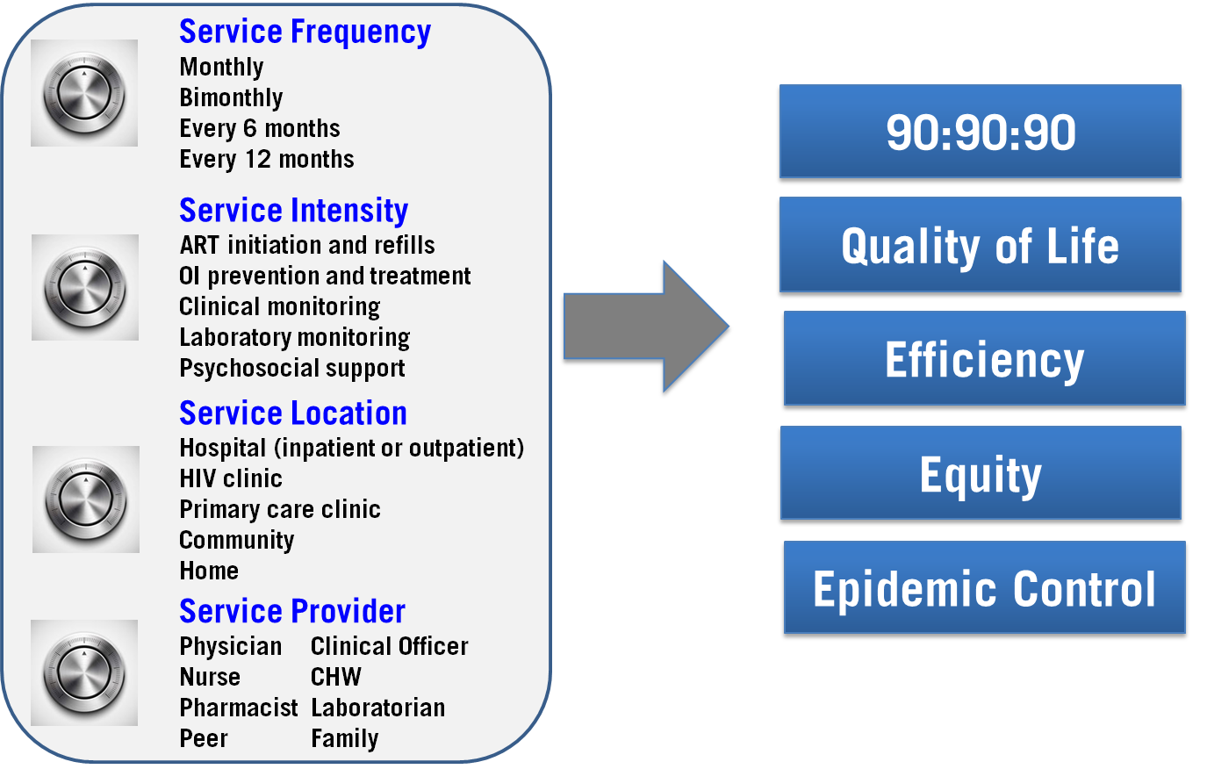
A Focus on the “How”

Slide 8
Illustrative DSD Models for “Stable” Patients
 | Individual | Group
Facility-based | Fast track Appointment spacing | ART clubs Teen clubs Family pick up
Community-based | Outreach model PODI model* | Community ART Groups (CAGs)
* PODI: Points de Distribution Communautaires
8

Slide 9

What is Necessary to Achieve the Promise of DSD?
Adoption
Implementation
Scale-up
Evaluation
Implementation
Evaluation
Scale-Up

Slide 10

Scale-up of differentiated service delivery

Slide 11
Defining “scale up” – 1
“The process of reaching large numbers of a target population in a broader geographic area by institutionalizing effective programs.”
- Cash et al. From One to Many, 2011

Slide 12
Defining “scale up” – 2
“Deliberate efforts to increase the impact of successfully tested health innovations so as to benefit more people and to foster policy and programme development on a lasting basis.”
- WHO/ExpandNet 2010

Slide 13
Scale-up Definitions:
Commonalities
Both definitions highlight two key dimensions:
  Expansion (“horizontal scale-up”)
  Institutionalization (“vertical scale-up”)
Goal = maximum impact
  “Small is beautiful but large is necessary” – BRAC

Slide 14
Horizontal versus Vertical Scale-up:
Examples
Expansion
(horizontal scale-up):
Increasing geographic coverage
Expanding to reach more people in existing sites/regions
Expanding the ‘depth’ or diversity of services provided to those already enrolled
Institutionalization
(vertical scale-up):
Policies, political commitment and legal frameworks
Regulations, norms and guidelines
Financing and budgets
Information systems
Standardizing training, supervision, support

Slide 15
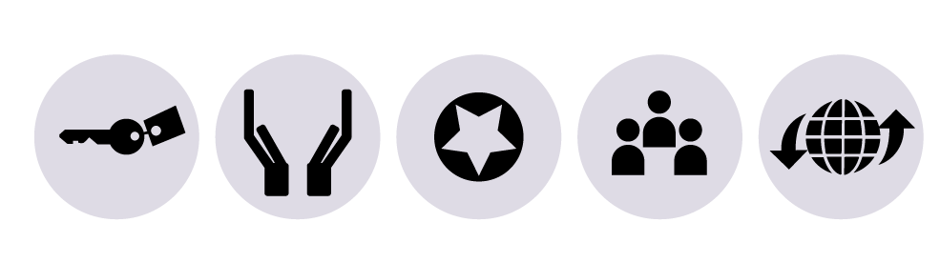
Coverage without Quality will NOT achieve ultimate goals
Coverage (utilization) + Quality = Impact
Access
Acceptability
Quality
Coverage
Effectiveness

Slide 16
The Coverage, Quality and Impact Network (CQUIN)
A learning network designed to accelerate scale-up of DSD in sub-Saharan Africa
Overall goal is to improve the coverage, quality and impact of HIV services by scaling up effective DSD models nationwide
Designed to anticipate and mitigate barriers that may limit DSD to pilot projects
Guided by Ministries of Health / demand-driven

Slide 17
CQUIN Network Members
Network Members
Cote d’Ivoire
Ethiopia
eSwatini
Kenya
Malawi
Mozambique
South Africa
Uganda
Zambia
Zimbabwe

Slide 18
CQUIN Focus Areas
Knowledge exchange
  Sharing information across countries as well as generating new knowledge and spreading best practices
Joint learning
  Solving problems together via collaboration and joint work to develop strategies, tools, and other resources
Innovation
  Collaboratively adapting existing knowledge and/or generating new interventions and strategies

Slide 19
CQUIN Activities

Slide 20
Virtual Communities of Practice
M&E of DSD
  Launched in September 2017
  Mozambique, Swaziland, Uganda, Zimbabwe
  Creating an M&E of DSD Framework
Patients at High Risk of HIV Disease Progression (P@HR)
  Launched in December 2017
  Malawi, South Africa, Swaziland, Uganda, Zimbabwe
  Creating P@HR screening tool for lay health workers
DSD Coordinators
  Launched February 2018
  Comprised of DSD focal points from CQUIN countries
  Bi-monthly calls and frequent communication via What’sApp

Slide 21

Catalytic Projects
Zimbabwe: Male engagement in DSD
Kenya: Adolescent preferences for DSDM
eSwatini: DSD for HIV and hypertension
Ethiopia: Patient/HCW response to appointment spacing
Cross-cutting: Review and modeling of costing data

Slide 22
Monitoring implementation and Scale-up of differentiated service delivery

Slide 23
Mapping DSD Implementation at
ICAP-Supported Facilities – P-FACTS
2
21
154
201
38
45
13 countries
722 facilities
5
1
10
222*
2
10
11
*One ART site excluded due to incomplete survey
Notes:
722 ICAP-supported facilities in 13 countries responded to the survey
This chart illustrates the number of facilities responding in each country. Note that while CI, DRC, and Mozambique had the largest number of facilities responding, ICAP supports a large proportion of ART facilities in countries such as Eswatini and Ethiopia—so a smaller n may bely representativeness in some cases.
The colors here represent DSD implementation, with green = facilities currently implementing DSD, yellow = planned in 6 mo, blue = no plans to implement

Slide 24
Timeline of DSD Scale-Up by
Facility Location
16
(19%)
61
(28%)
78
(36%)
28
(33%)
68
(28%)
187
(34%)
162
(30%)
98
(40%)
76
(35%)
41
(48%)
79
(32%)
196
(36%)
Urban
n=215
Semi-Urban
n=85
Rural
n=245
Total
n=545
Notes:
Similarly, when we look at the timeline of DSD scale-up by facility location, we can see differences in the proportion of facilities that implemented DSD over a year ago, within the last year, and facilities that plan to implement DSD in the near future. 36% of urban facilities implemented DSD over a year ago compared to 28% of rural facilities; while 40% of urban facilities have plans to newly implement DSD within 6 months compared to only 28% of urban facilities.

Slide 25
Number of DSD Models Implemented at Health Facilities
22
(6%)
7
(5%)
5
(9%)
10
(7%)
31
(20%)
89
(25%)
13
(22%)
45
(30%)
114
(75%)
40
(69%)
95
(63%)
249
(69%)
Urban
n=152
Semi-Urban
n=58
Rural
n=150
Total
n=360
Notes:
Out of all facilities currently implementing DSD models, about 70% have implemented only one model and 30% have implemented 2 or more models. However, when facilities are broken down into locations—namely urban or rural areas—we see that rural facilities have a larger proportion of sites implementing 2 or more models—37% compared to 25% in urban areas.

Slide 26
DSD Program Monitoring
Global monitoring
Aggregate data
Outcomes
Coverage
% on DSD with VLS
Outcomes
Program monitoring
% on DSD retained
% of
facilities
offering DSD
% initiating DSD
% enrolled in DSD
Coverage
Patient experience
HCW
experience
Cost and efficiency

Slide 27
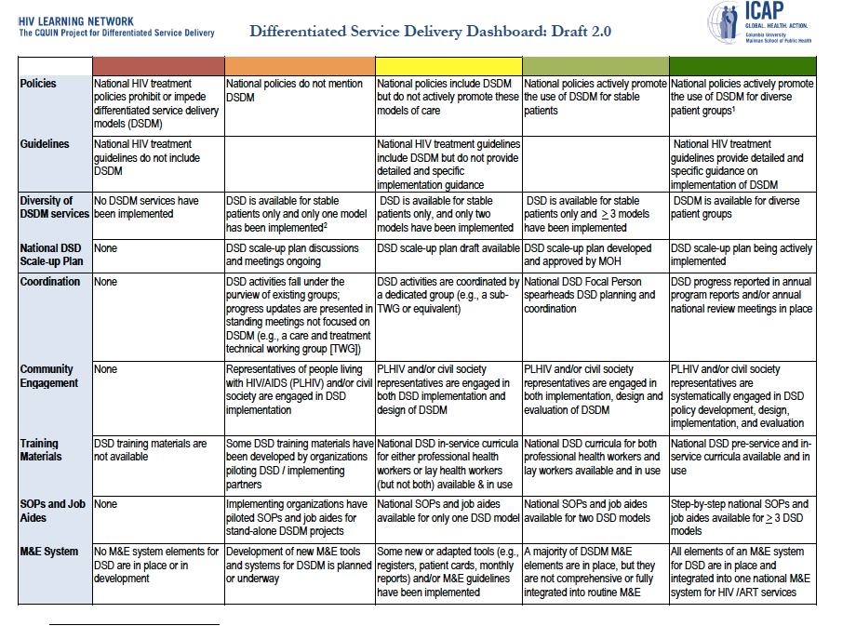

Slide 28
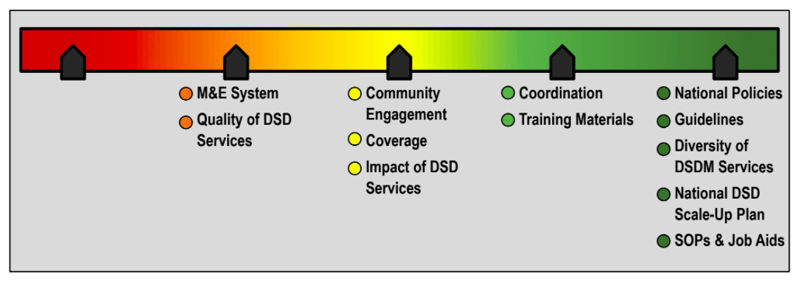
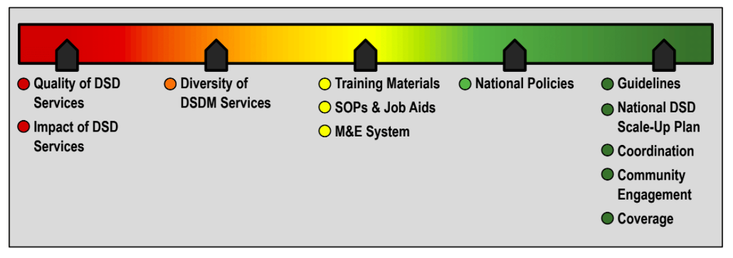
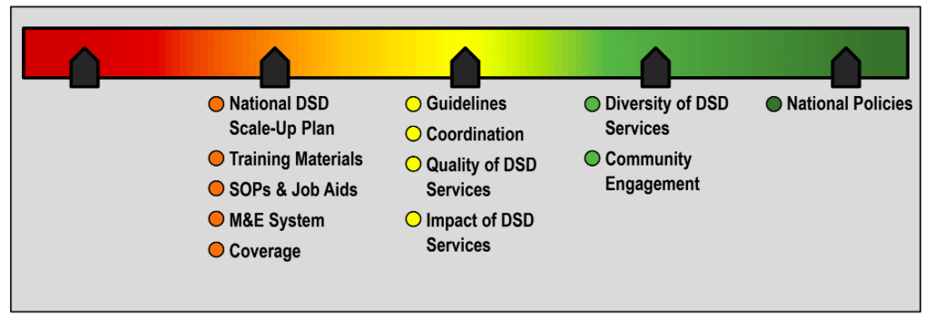
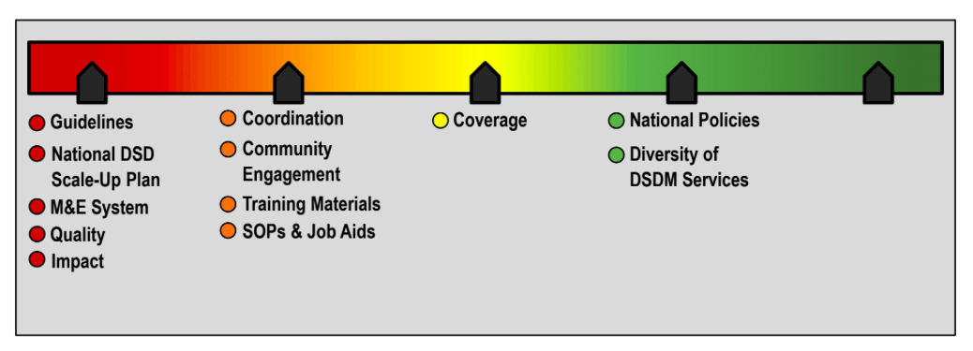
Staging by CQUIN Country Teams

Slide 29
Way Forward

Slide 30
DSD: Beyond “stable” patients
DSD models for patients at high risk of disease progression (P@HR)
Adolescents and young people
Men
Key populations
Migrant and mobile populations
Older individuals with HIV
PLHIV with TB or NCDs
Differentiated testing / differentiated prevention
Notes:
MIRIAM: Do you want to mention these as well?

Slide 31


Slide 32




Service Delivery Modalities for Key Populations
Drop-in Centers (DICs): combination of services and safe space for KPs
Outreach Clinics
  Hybrid: facilities where service provision
largely depend on other stakeholders
(public and private) health facilities
  Static: LINKAGES-supported clinics which
  provide services to KPs

Slide 33
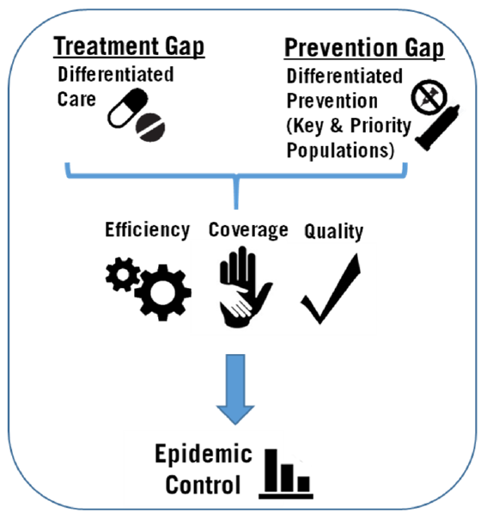
DSD for Prevention
El-Sadr, Harripersaud, Rabkin PLoS Med 2017

Slide 34
Conclusions
DSD models offer promise of enhancing quality of services, relieving overburdened health services and achieving efficiencies
Garnering these benefits is dependent on increasing coverage and quality of DSD
Scale-up of DSD models requires a systematic approach
Learning networks like CQUIN aim at joint learning and sharing while deepening commitment and motivation
Further work is needed to identify, implement and scale-up tailored DSD models with rigorous evaluation of their effectiveness

Slide 35
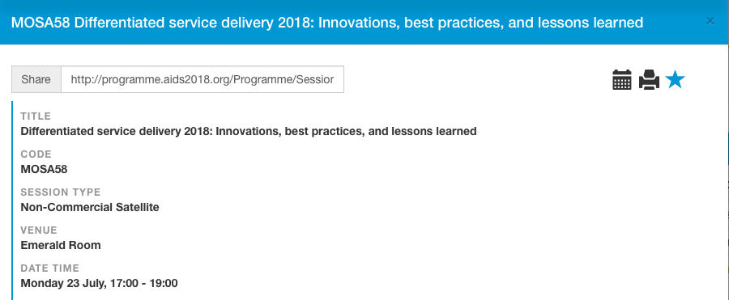
CQUIN Satellite on Monday,
July 23, 5-7 PM

Slide 36
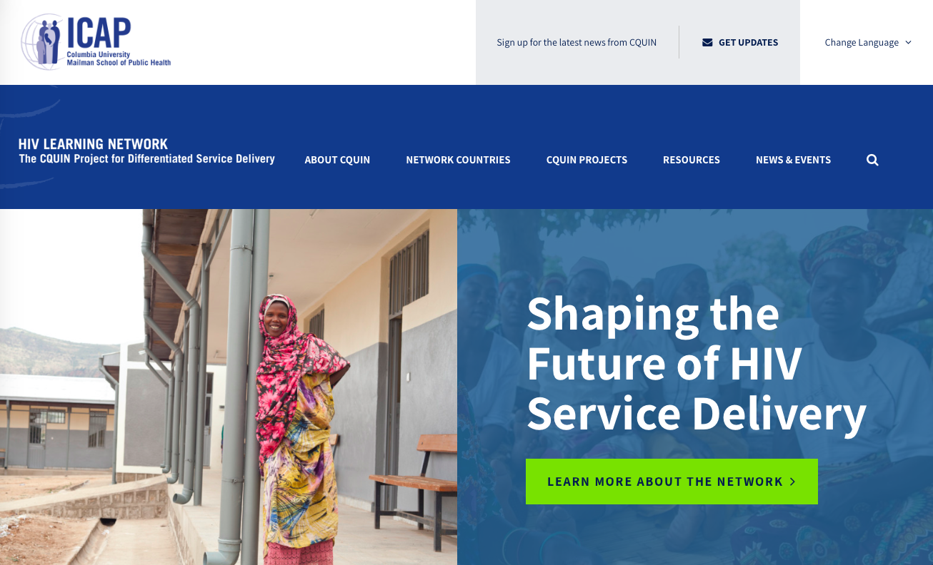
Acknowledgements
Miriam Rabkin, Peter Preko and Katherine Harripersaud and other ICAP staff
CQUIN Member Ministries of Health, partner organizations and community representatives
Funding from the Bill and Melinda Gates Foundation and support from Peter Ehrenkranz
CQUIN website:
https://cquin.icap.columbia.edu

